Slide 1
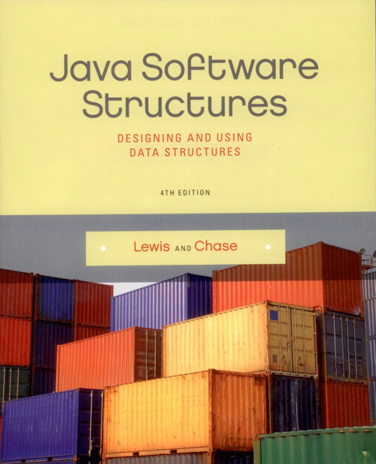
Chapter 13
Sets and Maps

Slide 2
Chapter Scope
The Java API set and map collections
Using sets and maps to solve problems
How the Java API implements sets and maps
Hashing

Slide 3
Sets
A set is a collection of elements with no duplicates
No other relationship among the elements should be assumed
A primary purpose of a set is to determine whether a particular element is a member
Other collections (such as lists) can test for containment, but if that operation is important, consider using sets

Slide 4
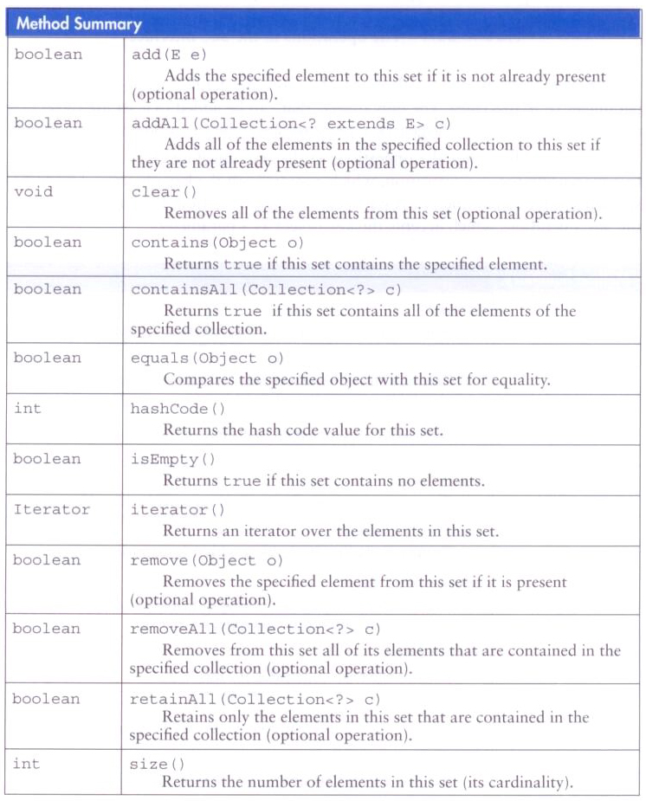
xxx
Operations on a set:

Slide 5
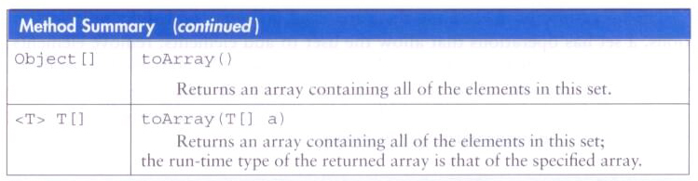
Sets
Operations on a set, continued:

Slide 6
Maps
A map is a collection that establishes a relationship between keys and values
The goal is to have an efficient way of obtaining a value given its key
Keys of a map must be unique, but multiple keys could map to the same object
For example, a membership id (a String) could be the key used to retrieve a member (a Member object)

Slide 7
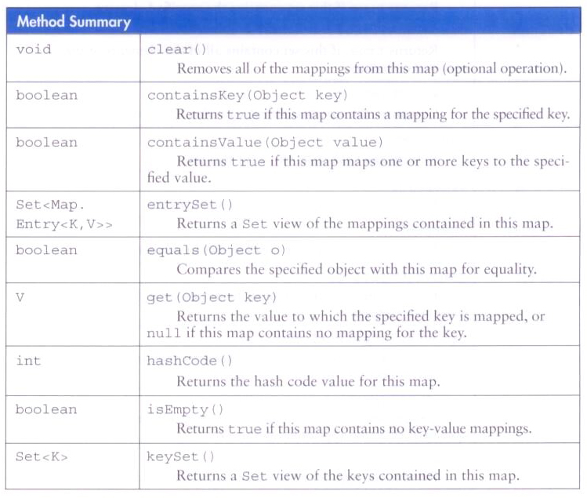
Maps
Operations on a map:

Slide 8
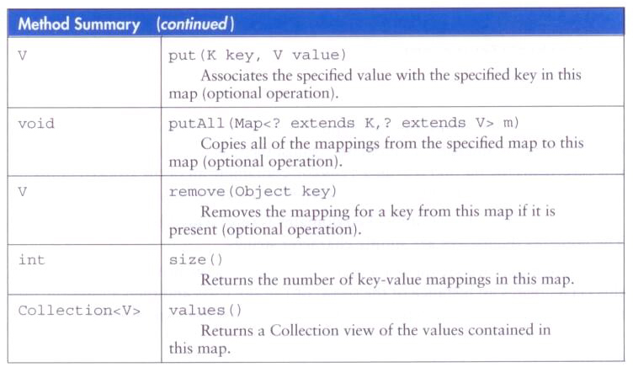
Maps
Operations on a map, continued:

Slide 9
Using Sets
Let's use a set to test for containment
In particular, we'll create a set of web domains that will be blocked
The blocked domains will be held in an input file
The set is represented using a TreeSet object from the Java API

Slide 10
import java.io.File;
import java.io.FileNotFoundException;
import java.util.Scanner;
import java.util.TreeSet;
/**
* A URL domain blocker.
*
* @author Lewis and Chase
* @version 4.0
*/
public class DomainBlocker
{
private TreeSet<String> blockedSet;
/**
* Sets up the domain blocker by reading in the blocked domain names from
* a file and storing them in a TreeSet.
* @throws FileNotFoundException
*/
public DomainBlocker() throws FileNotFoundException
{
blockedSet = new TreeSet<String>();
File inputFile = new File("blockedDomains.txt");
Scanner scan = new Scanner(inputFile);
while (scan.hasNextLine())
{
blockedSet.add(scan.nextLine());
}
}

Slide 11
/**
* Checks to see if the specified domain has been blocked.
*
* @param domain the domain to be checked
* @return true if the domain is blocked and false otherwise
*/
public boolean domainIsBlocked(String domain)
{
return blockedSet.contains(domain);
}
}

Slide 12
import java.io.FileNotFoundException;
import java.util.Scanner;
/**
* Domain checking driver.
*
* @author Lewis and Chase
* @version 4.0
*/
public class DomainChecker
{
/**
* Repeatedly reads a domain interactively from the user and checks to
* see if that domain has been blocked.
*/
public static void main(String[] args) throws FileNotFoundException
{
DomainBlocker blocker = new DomainBlocker();
Scanner scan = new Scanner(System.in);
String domain;

Slide 13
do
{
System.out.print("Enter a domain (DONE to quit): ");
domain = scan.nextLine();
if (!domain.equalsIgnoreCase("DONE"))
{
if (blocker.domainIsBlocked(domain))
System.out.println("That domain is blocked.");
else
System.out.println("That domain is fine.");
}
} while (!domain.equalsIgnoreCase("DONE"));
}
}

Slide 14
Using Maps
Now let's look at an example using maps to keep track of product sales
Suppose that each time a product is sold, its product code is entered into a sales file
Our example will read the sales file and update product sales summary
A TreeMap will be used to map the product code to the Product object

Slide 15
/**
* Represents a product for sale.
*
* @author Lewis and Chase
* @version 4.0
*/
public class Product implements Comparable<Product>
{
private String productCode;
private int sales;
/**
* Creates the product with the specified code.
*
* @param productCode a unique code for this product
*/
public Product(String productCode)
{
this.productCode = productCode;
this.sales = 0;
}

Slide 16
/**
* Returns the product code for this product.
*
* @return the product code
*/
public String getProductCode()
{
return productCode;
}
/**
* Increments the sales of this product.
*/
public void incrementSales()
{
sales++;
}

Slide 17
/**
* Compares this product to the specified product based on the product
* code.
*
* @param other the other product
* @return an integer code result
*/
public int compareTo(Product obj)
{
return productCode.compareTo(obj.getProductCode());
}
/**
* Returns a string representation of this product.
*
* @return a string representation of the product
*/
public String toString()
{
return productCode + "\t(" + sales + ")";
}
}

Slide 18
import java.io.File;
import java.io.IOException;
import java.util.Scanner;
import java.util.TreeMap;
/**
* Demonstrates the use of a TreeMap to store a sorted group of Product
* objects.
*
* @author Lewis and Chase
* @version 4.0
*/
public class ProductSales
{
/**
* Processes product sales data and prints a summary sorted by
* product code.
*/
public static void main(String[] args) throws IOException
{
TreeMap<String, Product> sales = new TreeMap<String, Product>();
Scanner scan = new Scanner(new File("salesData.txt"));
String code;
Product product;

Slide 19
while (scan.hasNext())
{
code = scan.nextLine();
product = sales.get(code);
if (product == null)
sales.put(code, new Product(code));
else
product.incrementSales();
}
System.out.println("Products sold this period:");
for (Product prod : sales.values())
System.out.println(prod);
}
}

Slide 20
Using Maps
Another example using maps stores user information which can be retrieved by a user id
This time, a HashMap is used to store the users

Slide 21
/**
* Represents a user with a userid.
*
* @author Lewis and Chase
* @version 4.0
*/
public class User
{
private String userId;
private String firstName;
private String lastName;
/**
* Sets up this user with the specified information.
*
* @param userId a user identification string
* @param firstName the user's first name
* @param lastName the user's last name
*/
public User(String userId, String firstName, String lastName)
{
this.userId = userId;
this.firstName = firstName;
this.lastName = lastName;
}

Slide 22
/**
* Returns the user id of this user.
*
* @return the user id of the user
*/
public String getUserId()
{
return userId;
}
/**
* Returns a string representation of this user.
*
* @return a string representation of the user
*/
public String toString()
{
return userId + ":\t" + lastName + ", " + firstName;
}
}

Slide 23
import java.util.HashMap;
import java.util.Set;
/**
* Stores and manages a map of users.
*
* @author Lewis and Chase
* @version 4.0
*/
public class Users
{
private HashMap<String, User> userMap;
/**
* Creates a user map to track users.
*/
public Users()
{
userMap = new HashMap<String, User>();
}
/**
* Adds a new user to the user map.
*
* @param user the user to add
*/
public void addUser(User user)
{
userMap.put(user.getUserId(), user);
}

Slide 24
/**
* Retrieves and returns the specified user.
*
* @param userId the user id of the target user
* @return the target user, or null if not found
*/
public User getUser(String userId)
{
return userMap.get(userId);
}
/**
* Returns a set of all user ids.
*
* @return a set of all user ids in the map
*/
public Set<String> getUserIds()
{
return userMap.keySet();
}
}

Slide 25
import java.io.IOException;
import java.util.Scanner;
/**
* Demonstrates the use of a map to manage a set of objects.
*
* @author Lewis and Chase
* @version 4.0
*/
public class UserManagement
{
/**
* Creates and populates a group of users. Then prompts for interactive
* searches, and finally prints all users.
*/
public static void main(String[] args) throws IOException
{
Users users = new Users();
users.addUser(new User("fziffle", "Fred", "Ziffle"));
users.addUser(new User("geoman57", "Marco", "Kane"));
users.addUser(new User("rover322", "Kathy", "Shear"));
users.addUser(new User("appleseed", "Sam", "Geary"));
users.addUser(new User("mon2016", "Monica", "Blankenship"));
Scanner scan = new Scanner(System.in);
String uid;
User user;

Slide 26
do
{
System.out.print("Enter User Id (DONE to quit): ");
uid = scan.nextLine();
if (!uid.equalsIgnoreCase("DONE"))
{
user = users.getUser(uid);
if (user == null)
System.out.println("User not found.");
else
System.out.println(user);
}
} while (!uid.equalsIgnoreCase("DONE"));
// print all users
System.out.println("\nAll Users:\n");
for (String userId : users.getUserIds())
System.out.println(users.getUser(userId));
}
}

Slide 27
Implementing Sets and Maps
The TreeSet and TreeMap classes use an underlying tree to hold the elements of the set or map
These trees are binary search trees, and in particular are red-black balanced trees
All of the basic operations are performed with O(log n) efficiency

Slide 28
Implementing Sets and Maps
The HashSet and HashMap classes are implemented using a technique called hashing
An element in a hash table is stored in a location based on a hash function
A hash function makes some calculation based on the element itself
Multiple elements may be stored in the same location (which is called a collision)
A function that maps each element to a unique location is called a perfect hashing function

Slide 29
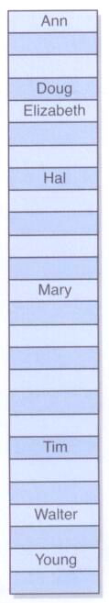
Hashing
A hash table with a simple hash function based on the first letter of the string:
Collisions would be managed using a list of A names, a list of B names, etc.

